Slide 1
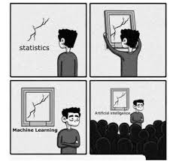
Unit I
Journey from Statistics to Machine Learning

Slide 2
Statistical terminology for model building and validation
Statistics is the branch of mathematics dealing with the collection, analysis, interpretation, presentation, and organization of numerical data.
Statistics are mainly classified into two sub branches:
Descriptive statistics: These are used to summarize data, such as the mean, standard deviation for continuous data types (such as age), whereas frequency and percentage are useful for categorical data (such as gender).
Inferential statistics: Many times, a collection of the entire data (also known as population in statistical methodology) is impossible, hence a subset of the data points is collected, also called a sample, and conclusions about the entire population will be drawn, which is known as inferential statistics. Inferences are drawn using hypothesis testing, the estimation of numerical characteristics, the correlation of relationships within data, and so on.

Slide 3
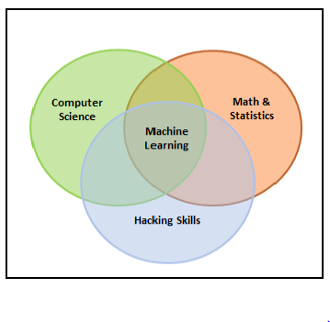
Machine learning
Machine learning is the branch of computer science that utilizes past experience to learn from and use its knowledge to make future decisions. Machine learning is at the intersection of computer science, engineering, and statistics. The goal of machine learning is to generalize a detectable pattern or to create an unknown rule from given examples.

Slide 4
Machine learning types
Machine learning is broadly classified into three categories but nonetheless, based on the situation, these categories can be combined to achieve the desired results for particular applications:
Supervised learning
Supervised learning (SL) is the machine learning task of learning a function that maps an input to an output based on example input-output pairs.
Unsupervised learning
Unsupervised learning is a type of algorithm that learns patterns from untagged data.
Reinforcement learning
Reinforcement learning ( RL) is an area of machine learning concerned with how software agents ought to take actions in an environment so as to maximize some notion of cumulative reward.

Slide 5
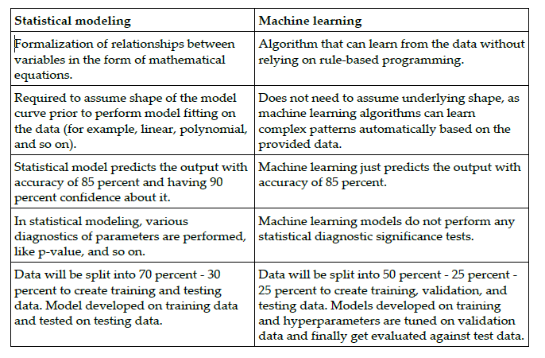
Major differences between statistical modeling and machine learning

Slide 6
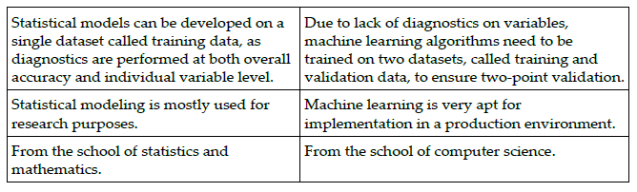

Slide 7
Steps in machine learning model development and deployment
Collection of data: Data for machine learning is collected directly from structured source data, web scrapping, API, chat interaction, and so on, as machine learning can work on both structured and unstructured data (voice, image, and text).
Data preparation and missing/outlier treatment: Data is to be formatted as per the chosen machine learning algorithm; also, missing value treatment needs to be performed by replacing missing and outlier values with the mean/median, and so on.
Data analysis and feature engineering: Data needs to be analyzed in order to find any hidden patterns and relations between variables, and so on. Correct feature engineering with appropriate business knowledge will solve 70 percent of the problems
Train algorithm on training and validation data: Post feature engineering, data will be divided into three chunks (train, validation, and test data) rather than two (train and test) in statistical modeling.
Test the algorithm on test data: Once the model has shown a good enough performance on train and validation data, its performance will be checked against unseen test data. If the performance is still good enough, we can proceed to the next and final step.
Deploy the algorithm: Trained machine learning algorithms will be deployed on live streaming data to classify the outcomes. One example could be recommender systems implemented by e-commerce websites.

Slide 8
Statistical fundamentals and terminology for model building and validation
Population: This is the totality, the complete list of observations, or all the data points about the subject under study
Sample: A sample is a subset of a population, usually a small portion of the population that is being analyzed.
Parameter versus statistic: Any measure that is calculated on the population is a parameter, whereas on a sample it is called a statistic.
Mean: This is a simple arithmetic average, which is computed by taking the aggregated sum of values divided by a count of those values.
Median: This is the midpoint of the data, and is calculated by either arranging it in ascending or descending order. If there are N observations.
Mode: This is the most repetitive data point in the data

Slide 9
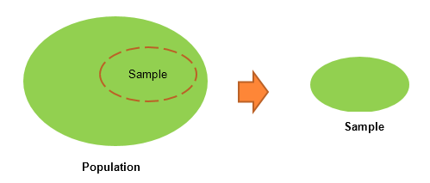
Population and Sampling

Slide 10
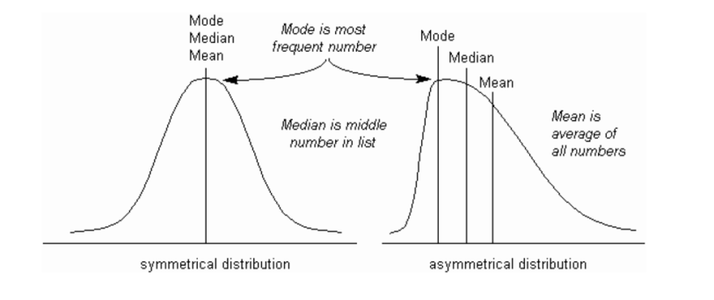
Mean, Mode and Median

Slide 11

Python code
The Python code for the calculation of mean, median, and mode using a numpy array and the stats package is as follows:
>>> import numpy as np
>>> from scipy import stats
>>> data = np.array([4,5,1,2,7,2,6,9,3])
# Calculate Mean
>>> dt_mean = np.mean(data) ;
print ("Mean :",round(dt_mean,2))
# Calculate Median
>>> dt_median = np.median(data) ; print ("Median :",dt_median)
# Calculate Mode
>>> dt_mode = stats.mode(data);
print ("Mode :",dt_mode[0][0])

Slide 12
Contd…
Measure of variation: Dispersion is the variation in the data, and measures the inconsistencies in the value of variables in the data.
Range: This is the difference between the maximum and minimum of the value.
Variance: This is the mean of squared deviations from the mean (xi = data points, µ = mean of the data, N = number of data points).
Standard deviation: This is the square root of variance. By applying the square root on variance, we measure the dispersion with respect to the original variable rather than square of the dimension:
Quantiles: These are simply identical fragments of the data. Quantiles cover percentiles, deciles, quartiles, and so on
Percentile: the percentage of data points below the value of the original whole data
Decile: This is 10th percentile, which means the number of data points below the decile is 10 percent of the whole data.
Quartile: : This is one-fourth of the data, and also is the 25th percentile. The first quartile is 25 percent of the data, the second quartile is 50 percent of the data, the third quartile is 75 percent of the data. The second quartile is also known as the median or 50th percentile or 5th decile.
Interquartile range: This is the difference between the third quartile and first quartile.

Slide 13
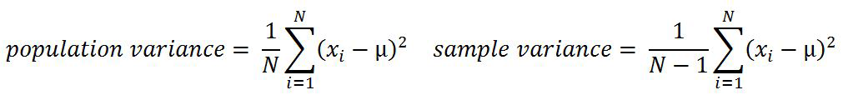
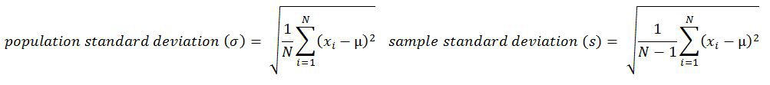
Contd…

Slide 14
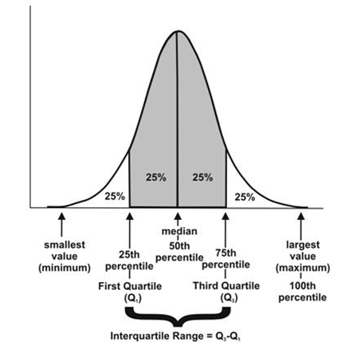
Contd…

Slide 15
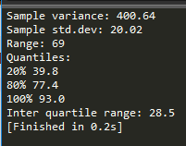
>>> from statistics import variance, stdev
>>> game_points =
np.array([35,56,43,59,63,79,35,41,64,43,93,60,77,24,82])
# Calculate Variance
>>> dt_var = variance(game_points) ; print ("Sample variance:",
round(dt_var,2))
# Calculate Standard Deviation
>>> dt_std = stdev(game_points) ; print ("Sample std.dev:",
round(dt_std,2))
# Calculate Range
>>> dt_rng = np.max(game_points,axis=0) -
np.min(game_points,axis=0) ; print ("Range:",dt_rng)
#Calculate percentiles
>>> print ("Quantiles:")
>>> for val in [20,80,100]:
>>> dt_qntls = np.percentile(game_points,val)
>>> print (str(val)+"%" ,dt_qntls)
# Calculate IQR
>>> q75, q25 = np.percentile(game_points, [75 ,25]);
print ("Inter quartile range:",q75-q25)

Slide 16
Contd…
Hypothesis testing: This is the process of making inferences about the overall population by conducting some statistical tests on a sample
P-value: The probability of obtaining a test statistic result is at least as extreme as the one that was actually observed, assuming that the null hypothesis is true (usually in modeling, against each independent variable, a p-value less than 0.05 is considered significant and greater than 0.05 is considered insignificant; nonetheless, these values and definitions may change with respect to context).
The steps involved in hypothesis testing are as follows:
1. Assume a null hypothesis (usually no difference, no significance, and so on; a null hypothesis always tries to assume that there is no anomaly pattern and is always homogeneous, and so on).
2. Collect the sample.
3. Calculate test statistics from the sample in order to verify whether the hypothesis is statistically significant or not.
4. Decide either to accept or reject the null hypothesis based on the test statistic.

Slide 17
Example of hypothesis testing
A chocolate manufacturer who is also your friend claims that all chocolates produced from his factory weigh at least 1,000 g and you have got a funny feeling that it might not be true; you both collected a sample of 30 chocolates and found that the average chocolate weight as 990 g with sample standard deviation as 12.5 g. Given the 0.05 significance level, can we reject the claim made by your friend?

Slide 18
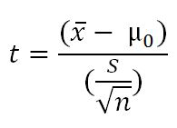

The null hypothesis is that μ0 ≥ 1000 (all chocolates weigh more than 1,000 g).
Collected sample:
t = (990 - 1000) / (12.5/sqrt(30)) = - 4.3818
Critical t value from t tables = t0.05, 30 = 1.699 => - t0.05, 30 = -1.699
P-value = 7.03 e-05

Slide 19
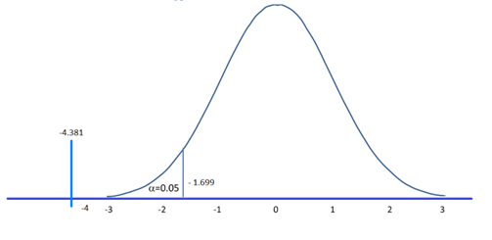

Slide 20
(Contd…)
Type I and II error: Hypothesis testing is usually done on the samples rather than the entire population, due to the practical constraints of available resources to collect all the available data.
Type I error: Rejecting a null hypothesis when it is true
Type II error: Accepting a null hypothesis when it is false
Normal distribution: This is very important in statistics because of the central limit theorem, which states that the population of all possible samples of size n from a population with mean μ and variance σ2 approaches a normal distribution
Chi-square: This test of independence is one of the most basic and common hypothesis tests in the statistical analysis of categorical data.
ANOVA: Analyzing variance tests the hypothesis that the means of two or more populations are equal. ANOVAs assess the importance of one or more factors by comparing the response variable means at the different factor levels

Slide 21
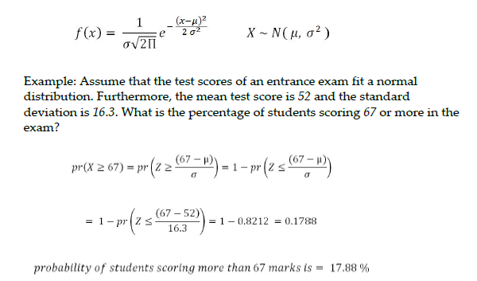

Slide 22
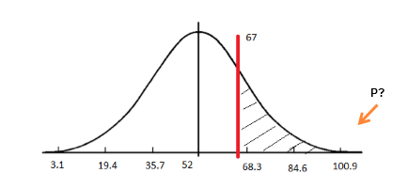

Slide 23

The Python code is as follows:
>>> from scipy import stats
>>> xbar = 67; mu0 = 52; s = 16.3
# Calculating z-score
>>> z = (67-52)/16.3
# Calculating probability under the curve
>>> p_val = 1- stats.norm.cdf(z)
>>> print ("Prob. to score more than 67 is
",round(p_val*100,2),"%")

Slide 24

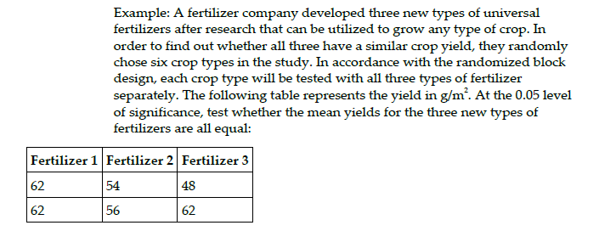
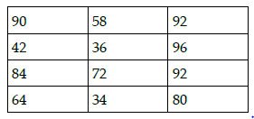
Chisquare equation and ANOVA example

Slide 25
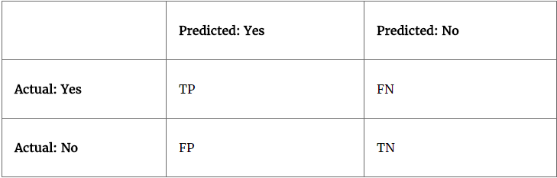
Confusion matrix

Slide 26
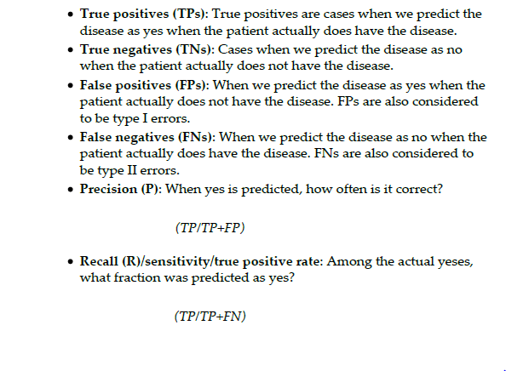

Slide 27
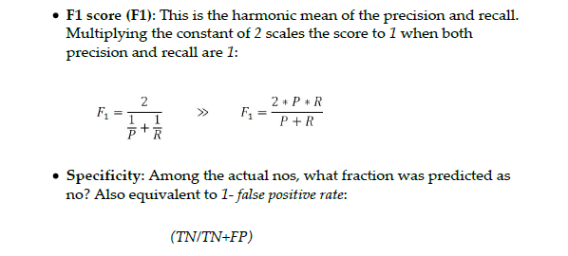

Slide 28
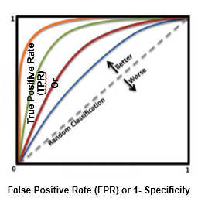
Area under curve (ROC)

Slide 29
(Contd…)
Observation and performance window: : In statistical modeling, the model tries to predict the event in advance rather than at the moment, so that some buffer time will exist to work on corrective actions.
In-time and out-of-time validation: In-time validation implies obtaining both a training and testing dataset from the same period of time, whereas out-of-time validation implies training and testing datasets drawn from different time periods.

Slide 30
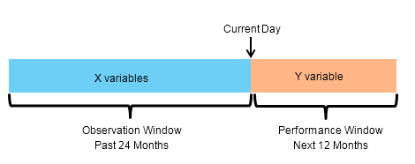

Slide 31
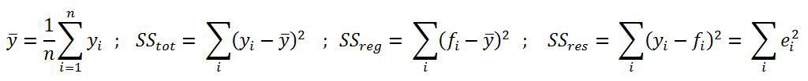
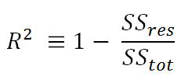
R-squared (coefficient of determination)

Slide 32
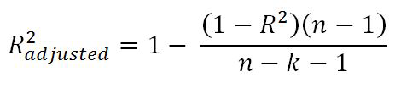
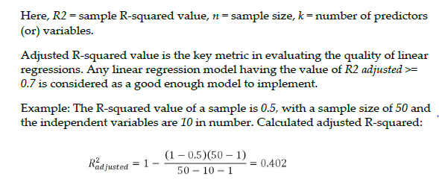
Adjusted R-squared

Slide 33
Maximum likelihood estimate (MLE): This is estimating the parameter values of a statistical model (logistic regression, to be precise) by finding the parameter values that maximize the likelihood of making the observations.
Akaike information criteria (AIC) : This is used in logistic regression, which is similar to the principle of adjusted R-square for linear regression
Entropy : This comes from information theory and is the measure of impurity in the data. If the sample is completely homogeneous, the entropy is zero and if the sample is equally divided, it has an entropy of 1.
Information gain : This is the expected reduction in entropy caused by partitioning the examples according to a given attribute. The idea is to start with mixed classes and to keep partitioning until each node reaches its observations of the purest class.

Slide 34



Slide 35
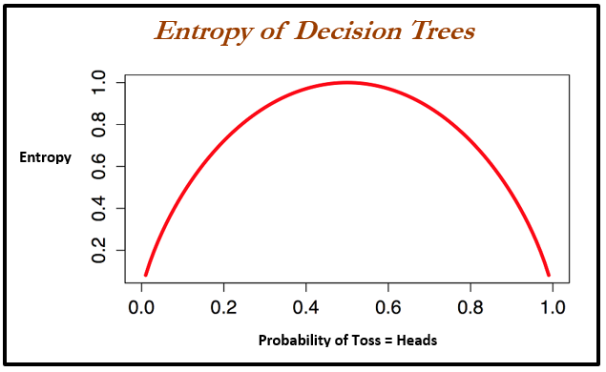

Slide 36
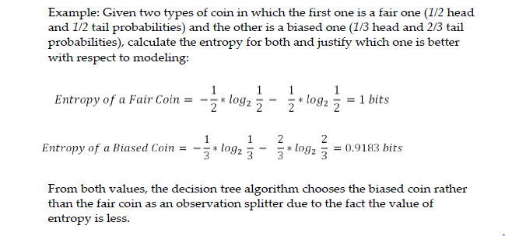

Slide 37
Information gain = Entropy of parent - sum (weighted % * Entropy of child)
Weighted % = Number of observations in particular child / sum (observations in all child nodes)

Slide 38

Gini

Slide 39
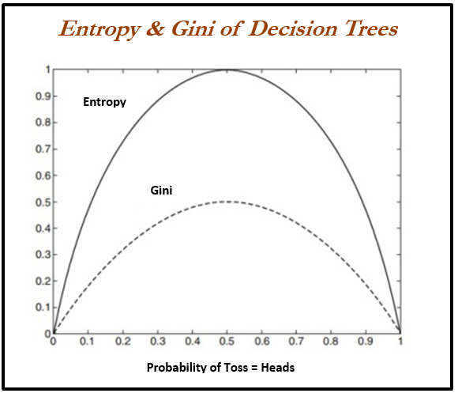

Slide 40

Bias versus variance trade-off
Every model has both bias and variance error components in addition to white noise. Bias and variance are inversely related to each other; while trying to reduce one component, the other component of the model will increase.
The true art lies in creating a good fit by balancing both. The ideal model will have both low bias and low variance.

Slide 41
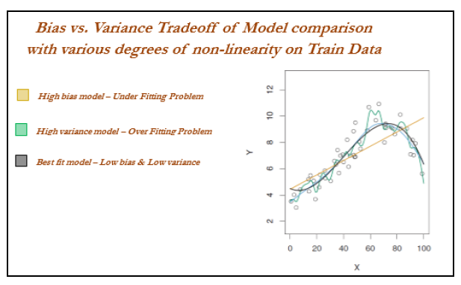
Contd…

Slide 42
Train and test data
Data usually will be split randomly 70-30 or 80-20 into train and test datasets respectively in statistical modeling, in which training data utilized for building the model and its effectiveness will be checked on test data:

Slide 43
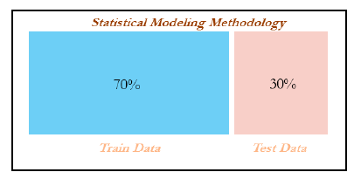
Contd…

Slide 44
Contd…
# Train & Test split
>>> import pandas as pd
>>> from sklearn.model_selection import train_test_split
>>> original_data = pd.read_csv("mtcars.csv")
>>> train_data,test_data = train_test_split(original_data,train_size = 0.7,random_state=42)

Slide 45
Machine learning terminology for model building and validation
A quick view has been provided as follows: in statistical modeling, linear regression with two independent variables is trying to fit the best plane with the least errors.
Whereas in machine learning independent variables have been converted into the square of error terms (squaring ensures the function will become convex, which enhances faster convergence and also ensures a global optimum) and optimized based on coefficient values rather than independent variables.

Slide 46
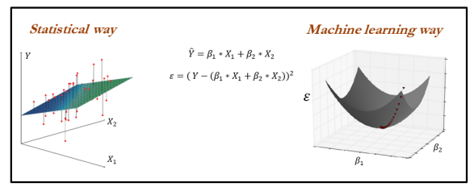

Slide 47
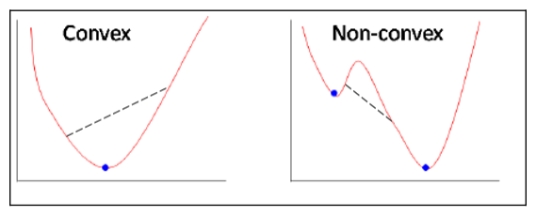

Slide 48
(Contd…)
Gradient descent: This is a way to minimize the objective function J(Θ) parameterized by the model's parameter Θ ε Rd by updating the parameters in the opposite direction to the gradient of the objective function with respect to the parameters.
Full batch gradient descent: In full batch gradient descent, all the observations are considered for each and every iteration; this methodology takes a lot of memory and will be slow as well.
Stochastic gradient descent: This method updates weights by taking one observation at each stage of iteration. This method provides the quickest way of traversing weights; however, a lot of noise is involved while converging.
Mini batch gradient descent (about 30 training observations or more for each and every iteration): This is a trade-off between huge computational costs and a quick method of updating weights.

Slide 49
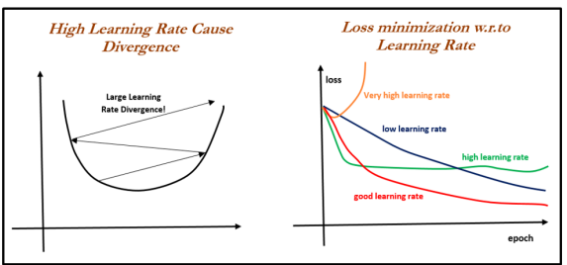

Slide 50
Linear regression versus gradient descent
Defining the gradient descent function gradient_descent with the following:
x: Independent variable.
y: Dependent variable.
learn_rate: Learning rate with which gradients are updated; too low causes slower convergence and too high causes overshooting of gradients.
batch_size: Number of observations considered at each iteration for updating gradients; a high number causes a lower number of iterations and a lower number causes an erratic decrease in errors. Ideally, the batch size should be a minimum value of 30 due to statistical significance.
max_iter: Maximum number of iteration, beyond which the algorithm will get auto-terminated:

Slide 51
Machine learning losses
The loss function or cost function in machine learning is a function that maps the values of variables onto a real number intuitively representing some cost associated with the variable values. Optimization methods are applied to minimize the loss function by changing the parameter values, which is the central theme of machine learning.
Zero-one loss is L0-1 = 1 (m <= 0); in zero-one loss, value of loss is 0 for m >= 0 whereas 1 for m < 0. The difficult part with this loss is it is not differentiable, non-convex, and also NP hard.
Surrogate losses used for machine learning in place of zero-one loss are given as follows. The zero-one loss is not differentiable, hence approximated losses are being used instead:
Squared loss (for regression)
Hinge loss (SVM)
Logistic/log loss (logistic regression).

Slide 52
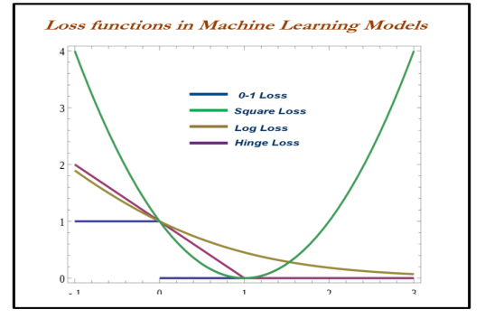

Slide 53
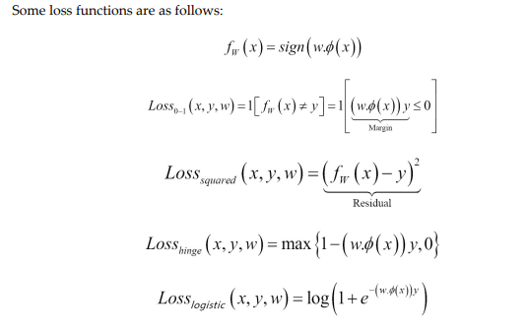
Contd…

Slide 54
When to stop tuning machine learning models
When to stop tuning the hyperparameters in a machine learning model is a million-dollar question. This problem can be mostly solved by keeping tabs on training and testing errors. While increasing the complexity of a model, the following stages occur:
Stage 1: Underfitting stage - high train and high test errors (or low train and low test accuracy)
Stage 2: Good fit stage (ideal scenario) - low train and low test errors (or high train and high test accuracy)
Stage 3: Overfitting stage - low train and high test errors (or high train and low test accuracy).

Slide 55
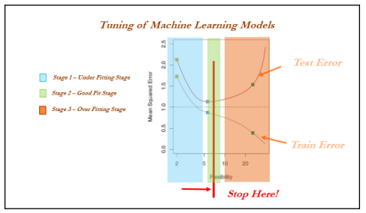

Slide 56
Train, validation, and test data
Cross-validation is not popular in the statistical modeling world for many reasons; statistical models are linear in nature and robust, and do not have a high variance/overfitting problem.
Hence, the model fit will remain the same either on train or test data, which does not hold true in the machine learning world.
Also, in statistical modeling, lots of tests are performed at the individual parameter level apart from aggregated metrics, whereas in machine learning we do not have visibility at the individual parameter level.

Slide 57
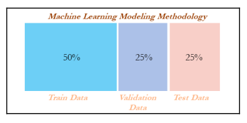

Slide 58
Cross-validation
Cross-validation is another way of ensuring robustness in the model at the expense of computation. In the ordinary modeling methodology, a model is developed on train data and evaluated on test data.
In some extreme cases, train and test might not have been homogeneously selected and some unseen extreme cases might appear in the test data, which will drag down the performance of the model.
Example: In five-fold cross-validation, data will be divided into five parts, subsequently trained on four parts of the data, and tested on the one part of the data. This process will run five times, in order to cover all points in the data. Finally, the error calculated will be the average of all the errors:

Slide 59
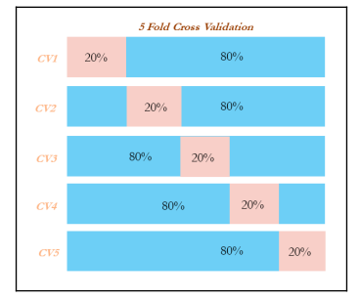

Slide 60
Grid search
Grid search in machine learning is a popular way to tune the hyperparameters of the model in order to find the best combination for determining the best fit.
Grid search has been implemented using a decision tree classifier for classification purposes.
Tuning parameters are the depth of the tree, the minimum number of observations in terminal node, and the minimum number of observations required to perform the node split.

Slide 61
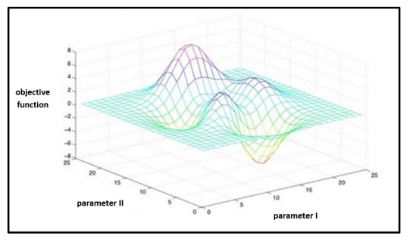
Contd…

Slide 62
Machine learning model overview
Machine learning models are classified mainly into supervised, unsupervised, and reinforcement learning methods. We will be covering detailed discussions about each technique in later chapters; here is a very basic summary of them:
Supervised learning: This is where an instructor provides feedback to a student on whether they have performed well in an examination or not. In which target variable do present and models do get tune to achieve it. Many machine learning methods fall in to this category:
Classification problems
Logistic regression
Lasso and ridge regression
Decision trees (classification trees)
Bagging classifier
Random forest classifier
Boosting classifier (adaboost, gradient boost, and xgboost)
SVM classifier
Recommendation engine
Regression problems
Linear regression (lasso and ridge regression)
Decision trees (regression trees)
Bagging regressor
Random forest regressor
Boosting regressor - (adaboost, gradient boost, and xgboost)
SVM regressor

Slide 63
Unsupervised learning: Similar to the teacher-student analogy, in which the instructor does not present and provide feedback to the student and who needs to prepare on his/her own. Unsupervised learning does not have as many are in supervised learning:
Principal component analysis (PCA)
K-means clustering
Reinforcement learning: This is the scenario in which multiple decisions need to be taken by an agent prior to reaching the target and it provides a reward, either +1 or -1, rather than notifying how well or how badly the agent performed across the path:
- Markov decision process
- Monte Carlo methods
- Temporal difference learning

Slide 64
Thank You

